Slide 1
CECS 326 Operating Systems
CPU Scheduling
(Chapter 6, Operating system Concepts by Silberschatz, Galvin and Gagne)

Slide 2
Basic Concepts
CPU-I/O burst cycle – process execution consists of a cycle of CPU execution and I/O wait
CPU burst followed by I/O burst
May increase CPU utilization with multiprogramming

Slide 3
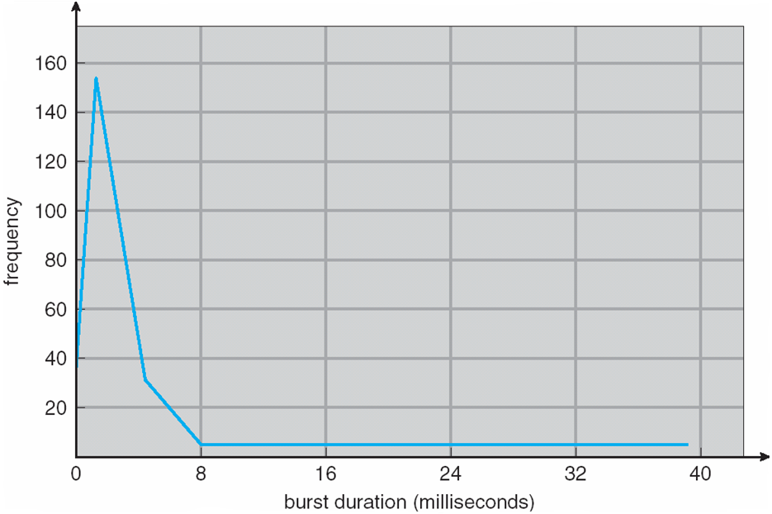
Histogram of CPU-burst Times
Generally characterized as an exponential or hyperexponential distribution, with a large number of short CPU bursts and a small number of long CPU bursts.
I/O-bound programs typically have many short CPU bursts, while CPU-bound programs might have a few long CPU bursts.

Slide 4
CPU Scheduler
When the CPU becomes idle, the short-term scheduler selects one of the processes from the ready queue to be executed
Queue may be ordered in various ways
CPU scheduling decisions may take place when a process:
Switches from running to waiting state
Switches from running to ready state
Switches from waiting to ready
Terminates
Scheduling under 1 and 4 is nonpreemptive
Scheduling under 2 and 3 is preemptive
Need to be aware of race conditions when data are shared among processes

Slide 5
Dispatcher
The dispatcher module gives control of the CPU to the process selected by the short-term scheduler, this involves:
Switching context
Switching to user mode
Jumping to the proper location in the user program to restart program
Dispatch latency – time it takes for the dispatcher to stop one process and start another running, which should be as fast as possible since it is invoked in every process switch

Slide 6
Performance Measures of Scheduling Algorithms
CPU utilization – keep the CPU as busy as possible (Maximize)
Throughput – # of processes that complete their execution per time unit (Maximize)
Turnaround time – amount of time to execute a particular process (Minimize)
Waiting time – amount of time a process has been waiting in the ready queue (Minimize)
Response time – amount of time it takes from when a request was submitted until the first response is produced, not output (for time-sharing environment) (Minimize)

Slide 7
First-Come, First-Served (FCFS) Scheduling
Given Process Burst Time
P₁ 24
P₂ 3
P₃ 3
Suppose three processes arrive in the order P₁ , P₂ , P₃
Gantt chart for the FCFS schedule is:
Waiting time for P₁ = 0; P₂ = 24; P₃ = 27
Average waiting time: (0 + 24 + 27)/3 = 17

Slide 8
FCFS Scheduling (cont.)
Suppose the three processes arrive in the order P₂ , P₃ , P₁
Then Gantt chart for the schedule is
Waiting time for P₁ = 6; P₂ = 0; P₃ = 3
Average waiting time: (6 + 0 + 3)/3 = 3
Much better than previous case
Convoy effect - short process behind long process
E.g., consider one CPU-bound and many I/O-bound processes

Slide 9
Shortest-Job-First (SJF) Scheduling
Associate with each process the length of its next CPU burst, and use these lengths to schedule the process with the shortest time
SJF schedule is optimal – it gives the minimum waiting time for a given set of processes
Difficulty is knowing the length of the next CPU request
Example: ProcessArriva l Burst Time
P₁ 0.0 6
P₂ 2.0 8
P₃ 4.0 7
P₄ 5.0 3
SJF scheduling chart
Average waiting time = (3 + 16 + 9 + 0) / 4 = 7

Slide 10
Determining Length of Next CPU Burst
Can only estimate – should be similar to the previous one – then pick process with shortest predicted next CPU burst
Can be done by using the length of previous CPU bursts using exponential averaging
Commonly, α set to ½
The preemptive version is called shortest-remaining-time-first

Slide 11
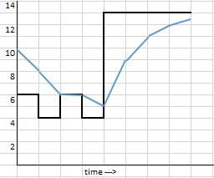

Prediction of the Length of the Next CPU Burst
Prediction ($τ_{i}$) 10 8 6 6 5 9 11 12
Actual ($t_{i}$) 6 4 6 4 13 13 13 13

Slide 12
Examples of Exponential Averaging
α =0
τ_{n+1} = τ_{n}
Recent history does not count
α =1
τ_{n+1} = α t_{n} = t_{n}
Only the actual last CPU burst counts
If we expand the formula, we get:
τ_{n+1} = α t_{n}+(1 - α)α t_{n} ₋₁ + …
+(1 - α )^{j} α t_{n} _{-j} + …
+(1 - α )^{n +1} τ₀
Since both α and (1 - α) are less than or equal to 1, each successive term has less weight than its predecessor

Slide 13
Example of Shortest-Remaining-Time-First Scheduling
Add the concepts of varying arrival times and preemption to the analysis
ProcessA Arrival TimeT Burst Time
P₁ 0 8
P₂ 1 4
P₃ 2 9
P₄ 3 5
Preemptive SJF Gantt Chart
Average waiting time = [(10-1)+(1-1)+(17-2)+5-3)]/4 = 26/4 = 6.5

Slide 14
Priority Scheduling
A priority number (integer) is associated with each process
The CPU is allocated to the process with the highest priority (convention: smallest integer ≡ highest priority). Scheduling may be preemptive or nonpreemptive.
SJF is priority scheduling where priority is based on the predicted next CPU burst time
Problem: starvation (low priority processes may have to wait a long time to get executed
Solution: aging (priority of process increases as time progresses)

Slide 15
Example of Priority Scheduling (Nonpreemptive)
Given the following processes in the system
ProcessA Burst TimeT Priority
P₁ 1 1
P₂ 5 2
P₃ 2 4
P₄ 1 5
P₅ 10 3
Priority scheduling Gantt Chart
Average waiting time = 8.2 msec
P
P
P
P
P
1
2
5
3
4
0
1
6
1
6
1
8
1
9

Slide 16
Round Robin (RR) Scheduling
Each process gets a small unit of CPU time (time quantum q), usually 10-100 milliseconds. After this time has elapsed, the process is preempted and added to the end of the ready queue.
If there are n processes in the ready queue and the time quantum is q, then each process gets 1/n of the CPU time in chunks of at most q time units at once. No process waits more than (n-1)q time units.
Timer interrupts every quantum to schedule next process
Performance
q large ⇒ FIFO
q small ⇒ q must be large with respect to context switch, otherwise overhead is too high

Slide 17
Example of RR with Time Quantum q = 4
Process Burst Time
P₁ 24
P₂ 3
P₃ 3
The Gantt chart is:
Typically, higher average turnaround than SJF, but better response
q should be large compared to context switch time
E.g., q may be set to 10ms to 100ms,with context switch < 10 μsec

Slide 18
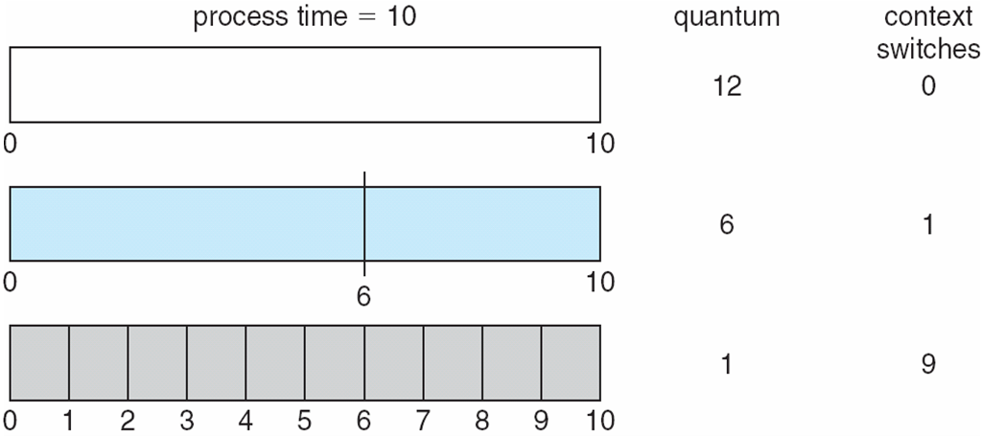
Time Quantum and Context Switch Time

Slide 19
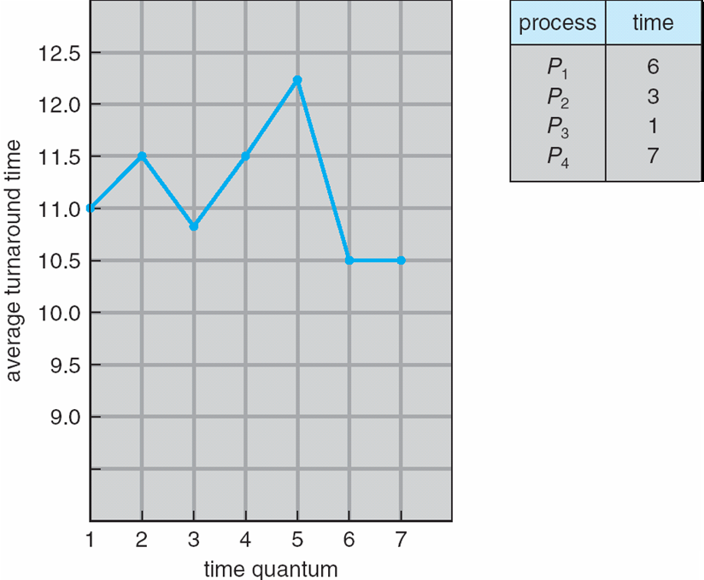
Turnaround Time Varies with Time Quantum
80% of CPU bursts should be shorter than q

Slide 20
Multilevel Queues
Ready queue is partitioned into separate queues, eg:
foreground (interactive)
background (batch)
Process permanently in a given queue
Each queue has its own scheduling algorithm:
foreground – RR
background – FCFS
Scheduling must be done between the queues:
Fixed priority scheduling; (i.e., serve all from foreground then from background). Possibility of starvation.
Time slice – each queue gets a certain amount of CPU time which it can schedule amongst its processes; e.g., 80% to foreground in RR, 20% to background in FCFS

Slide 21
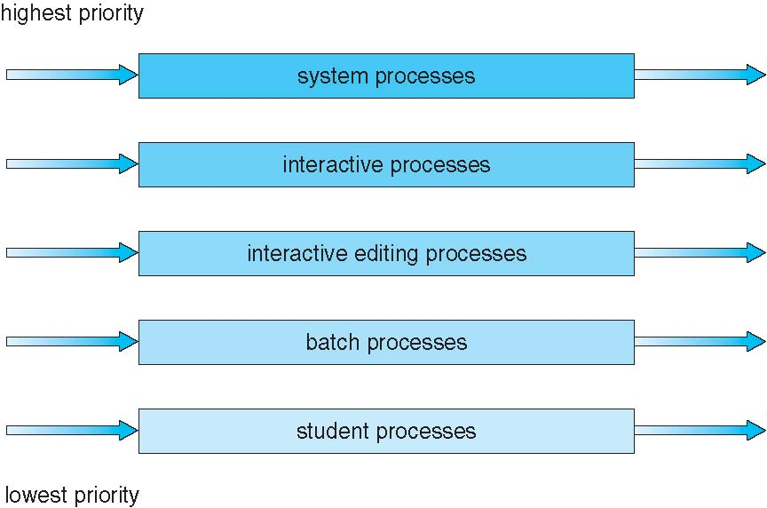
Multilevel Queue Scheduling

Slide 22
Multilevel Feedback Queue
A process can move between the various queues; aging can be implemented this way
Multilevel-feedback-queue scheduler defined by the following parameters:
number of queues
scheduling algorithms for each queue
method used to determine when to upgrade a process
method used to determine when to demote a process
method used to determine which queue a process will enter when that process needs service

Slide 23
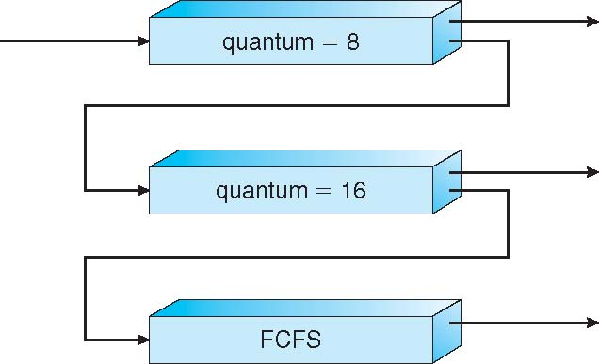
Example of Multilevel Feedback Queue
Three queues:
Q₀ – RR with time quantum 8 milliseconds
Q₁ – RR time quantum 16 milliseconds
Q₂ – FCFS
Scheduling
A new job enters queue Q₀ which is served FCFS
When it gains CPU, job receives 8 milliseconds
If it does not finish in 8 milliseconds, job is moved to queue Q₁
At Q₁ job is again served FCFS and receives 16 additional milliseconds
If it still does not complete, it is preempted and moved to queue Q₂

Slide 24
Multiple-Processor Scheduling
CPU scheduling becomes more complex when multiple CPUs are available
Multiprocessor architecture: homogeneous processors or heterogeneous processors within a multiprocessor
Approaches to multiple-processor scheduling
Asymmetric multiprocessing – only one processor accesses the system data structures, alleviating the need for data sharing
Symmetric multiprocessing (SMP) – each processor is self-scheduling, all processes in common ready queue, or each has its own private queue of ready processes
Currently, most common
Processor affinity – process has affinity for processor on which it is currently running
soft affinity – attempt to keep on the same processor, but not guaranteed
hard affinity
Variations including processor sets

Slide 25
Multiple-Processor Scheduling – Load Balancing
If SMP, need to keep all CPUs loaded for efficiency
Load balancing attempts to keep workload evenly distributed. Needed when each processor has its own private queue of ready processes
Push migration – a task periodically checks load on each processor, and, if found imbalance, pushes task from overloaded CPU to other CPUs
Pull migration – idle processors pulls waiting task from busy processor

Slide 26
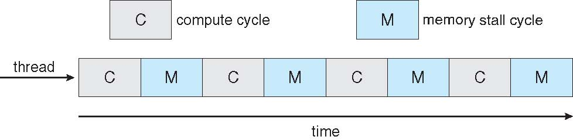

Multicore Processors
Recent trend to place multiple processor cores on same physical chip
Benefits: faster and consumes less power
The practice of multiple threads per core is also growing
Takes advantage of memory stall to make progress on another thread while memory retrieve happens

